Slide 1
Interacting with Te Ture Whenua to Benefit Iwi
Peter Johnston
13 April 2016
Māori Legal, Business & Governance Forum

Slide 2
Outline
Brief overview of key statistics
Possible benefits to iwi
Impact on Māori trusts and incorporations
Utilisation of MFH land
What next?

Slide 3
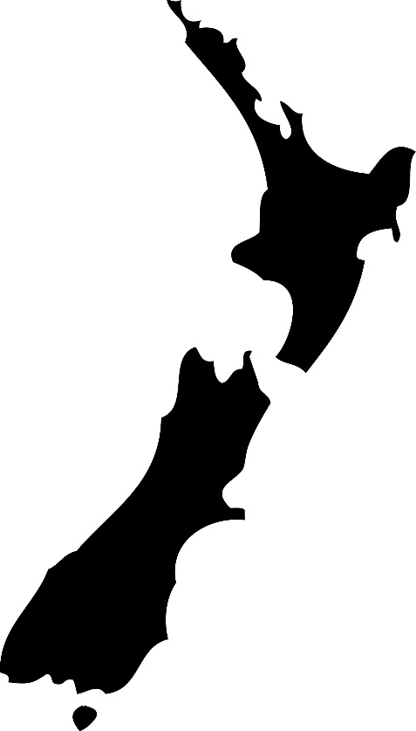
Te Ture Whenua Māori Act 1993
Governs Māori land
Came into force 1 July 1993
Retention
Utilisation
Repeal & replace
Not a final draft

Slide 4
Overview of Māori Land
Key statistics
Māori Freehold Land
Governance
Utilisation

Slide 5
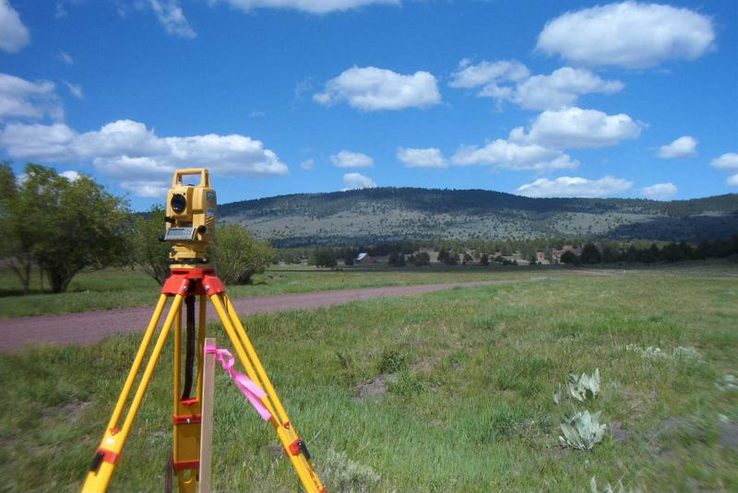
Māori freehold land
1.4 million ha
5.5% of New Zealand’s land mass
12% of the North Island
Over 27,400 titles
Average size is 54 ha

Slide 6
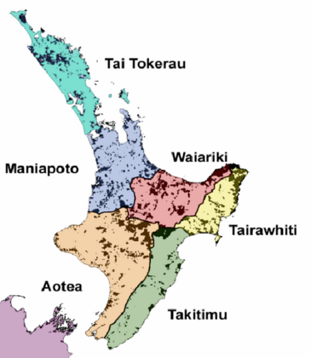
Māori freehold land location
Mostly located in the centre and east coast of the North Island:
Waiariki
Tairāwhiti
Aotea

Slide 7
Māori Land Governance
78% of MFL vested in governance body
Vested: average size of 99ha and 217 owners
Unvested: average size of 20ha and 7 owners

Slide 8
Regional differences
Governance levels vary:
Waiariki
Tairāwhiti
Aotea
Te Waipounamu
Taitokerau

Slide 9
Māori Land Utilisation Rates
20% well developed
40% under-performing
40% under utilised

Slide 10
Benefits to iwi from Te Ture Whenua
Historically:
Remove land from communal ownership
Individualisation
Alienation

Slide 11
Benefits to iwi under TTWM Act 1993
Mainly indirect
Māori Trusts & Incorporations
Asset base $12.5b
Beneficiary entitlements
Employment

Slide 12
Benefits to iwi under reform
Wait and see
Monitor progress

Slide 13
Under Te Ture Whenua Act 1993
Sale of MFH Land
Iwi not a preferred class
No right of first refusal
No preferential treatment

Slide 14
Position under current reforms
Iwi preferred status
Purchase ahead of general public
Help ensure retention of MFH lands in hands of whānau, hapū & iwi

Slide 15
Te Ture Whenua - Use in Practice/ Benefit to Community
Existing successful Māori Trusts and Incorporations
Raising level of MFH land governance
Raising level of performance of governors
Raising the level of land utilisation

Slide 16
Successful Māori Trusts and Incorporations
$12.5b asset base
Tried and tested
Abandoned proposals:
“One size fits all” Rangatōpū Governance Structure
Constitution
Major transaction
Dispute resolution

Slide 17
Raising level of MFH Land governance
Regional differences
Role of Māori Land Service
Codified process

Slide 18
Raising the levels of performance of governors
Upskilling and training
Existing governors
New governors
Role of Māori Land Service

Slide 19
Raising the level of land utilisation
Where no governing body
Landowner decision making
Quorum requirements
Role of Māori Land Service

Slide 20
Reform – What next?
Opportunities
Risks
Reforms not final
Get involved
Select Committee process

Slide 21
Questions?

Slide 22
Interacting with Te Ture Whenua to Benefit Iwi
Peter Johnston
13 April 2016
Māori Legal, Business & Governance Forum

